Slide 1
Data Definition
C393: Database Systems

Slide 2
Review

Slide 3
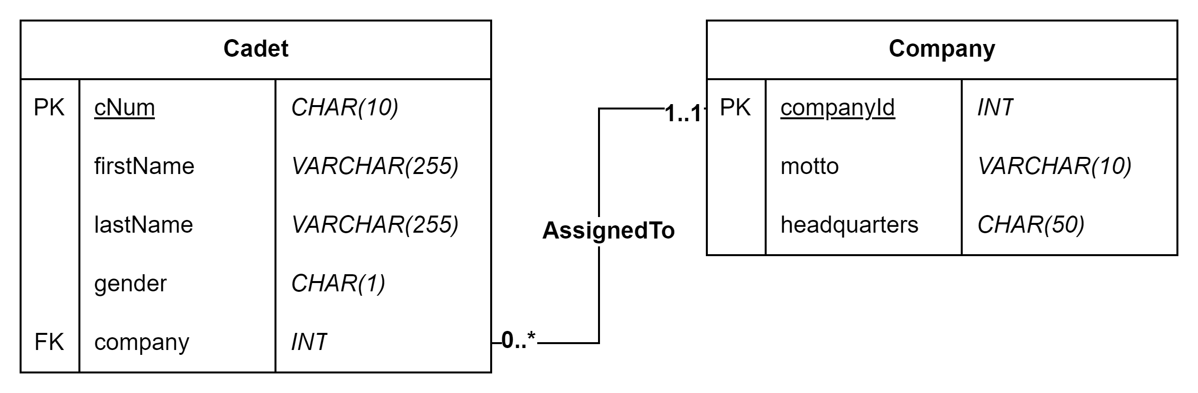
Design Diagrams

Slide 4
Lesson Objectives
Utilize SQL statements to create a database from a design diagram
Modify an existing database to match a design diagram

Slide 5
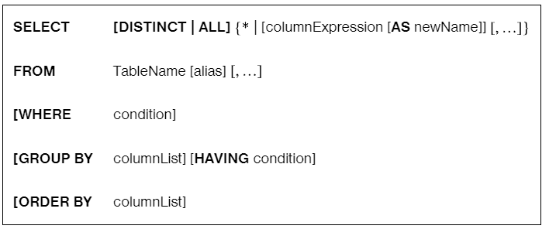
SQL Basics
By convention:
SQL keywords in UPPERCASE
Identifiers in camelCase (except Entities)
Reading examples:

Slide 6
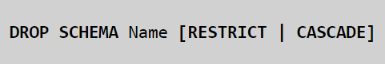
Another Example from the book

Slide 7
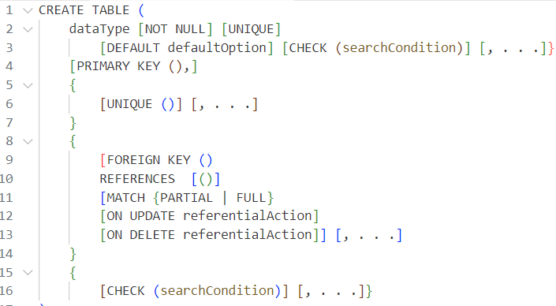
Another Example from the book

Slide 8
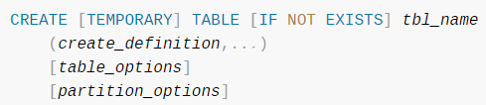
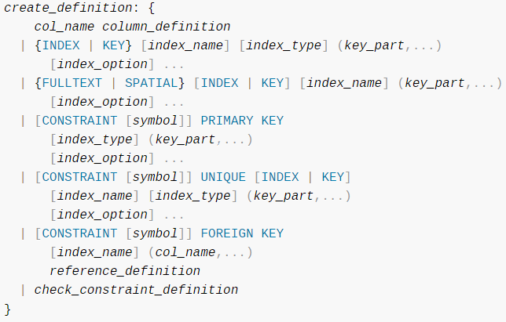
Better…
MySQL :: MySQL 8.4 Reference Manual :: 15 SQL Statements

Slide 9
Even better…
MySQL cheatsheet (devhints.io)
MySQL CREATE TABLE Statement (w3schools.com)
Make your own!

Slide 10
A Note: Identifiers
Any objects created by the database or the user
Does not include records
Does not include values in records
Queries, Views, Tables, Attributes, Indices, Constraints, etc
Must start with letter
<128 characters
No spaces!

Slide 11
Creating A Database
CREATE DATABASE DatabaseName;
CREATE TABLE TableName (
columnName DATATYPE [OPTIONS]
[, ...]
[, FOREIGN KEY (columnName) REFERENCES TableName(columnName) [, ...]]
[, CONSTRAINTS, ...]
)
DROP DATABASE DatabaseName;
DROP TABLE TableName;

Slide 12
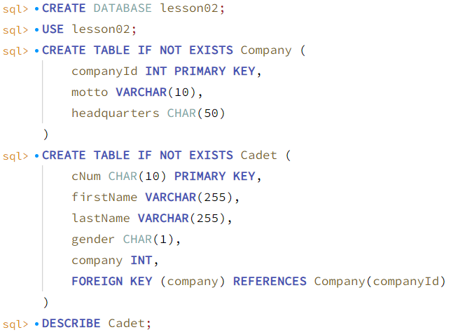
An Example
USE tells MySQL which database you are working with
DESCRIBE gives you the table definition
Notes:
Display the solution after this

Slide 13
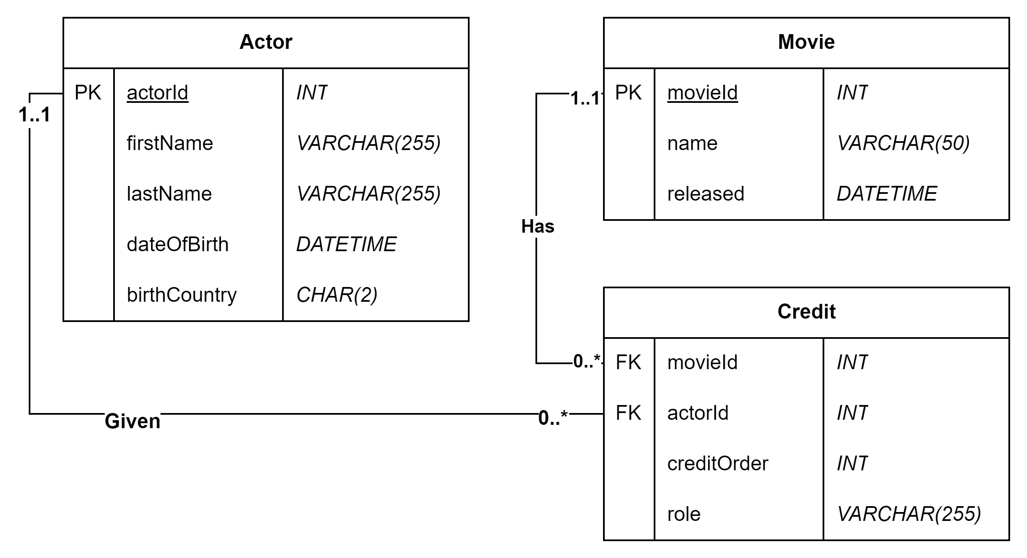
Your Turn…
Open and implement the diagram
VS Code MySQL Extension
or MySQL Workbench
In VS Code -> Ctrl + Enter = execute and move to next block
What if I mess up? DROP TABLE TableName; Then recreate it ☺
Notes:
Display the solution after this

Slide 14
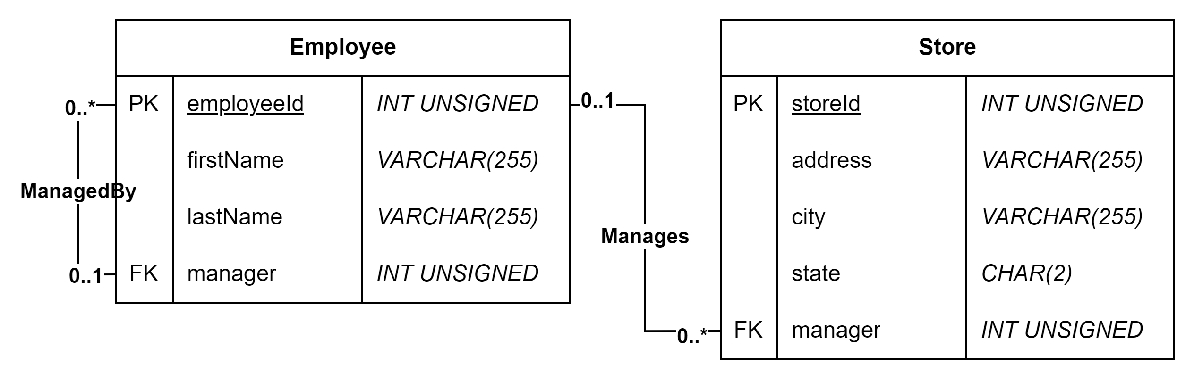
Let’s Try Another…
Notes:
Display the solution after this

Slide 15
Investigating a Database
SHOW [DATABASES | TABLES];
DESCRIBE TableName;

Slide 16
Another Exercise…
Run the new_database.sql script (no peeking!)
Use SHOW and DESCRIBE to recreate the database design diagram in draw.io

Slide 17
Altering Tables

Slide 18
Drops
DROP [DATABASE DatabaseName | TABLE TableName];
Drops without confirmation…

Slide 19
Alter
ALTER TABLE TableName
[ADD COLUMN columnName DATATYPE] |
[DROP COLUMN columnName] |
[MODIFY COLUMN columnName DATATYPE] |
[ADD FOREIGN KEY (columnName) REFERENCES TableName(columnName)] |
[ADD PRIMARY KEY (columnName [, ...])]

Slide 20
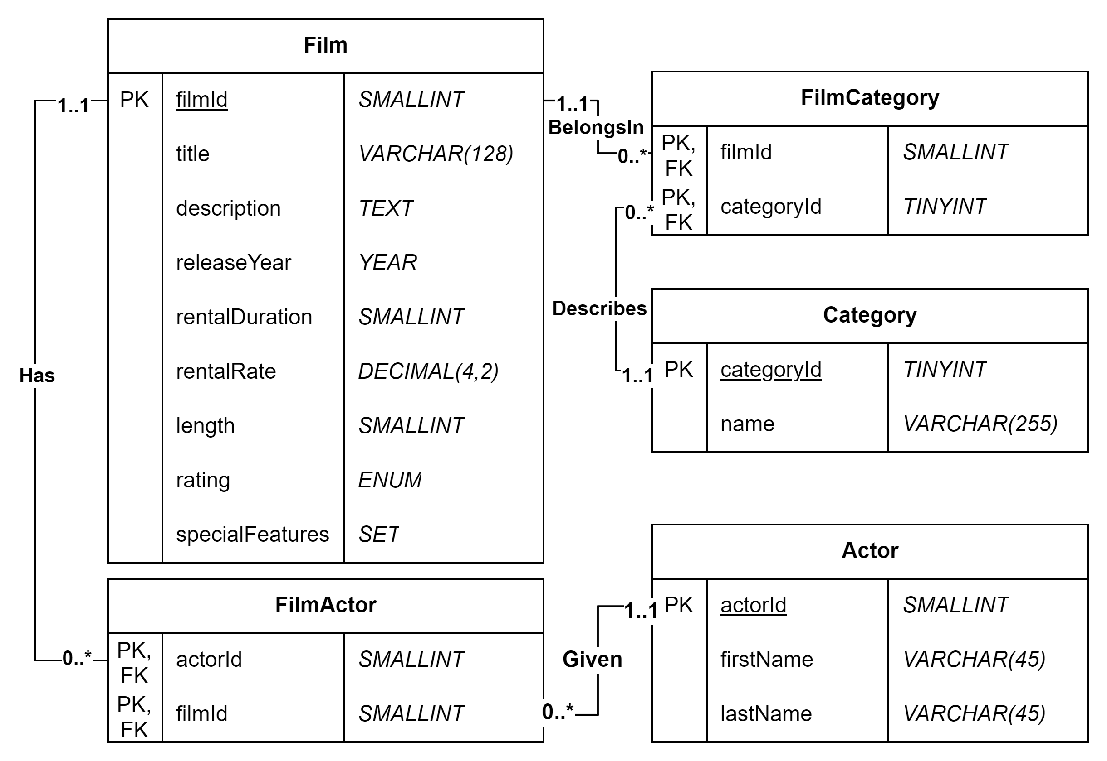
Another Exercise
Look at the design diagram for actor_film_category
Correct the database to match diagram
SHOW, DESCRIBE
ALTER

Slide 21
Need to see it again?
Available in Canvas:
SQL notebooks,
Design diagrams,
SQL scripts
MySQL Online Editor (onecompiler.com)

